Slide 1
Microwave Devices E511
Lecture 11
Amr Al.Awamry

Slide 2
Agenda
COUPLED LINES
Directional coupler using coupled lines
MW Filter design

Slide 3
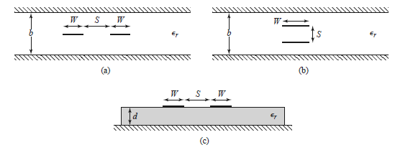
COUPLED LINES
Planner
stacked

Slide 4
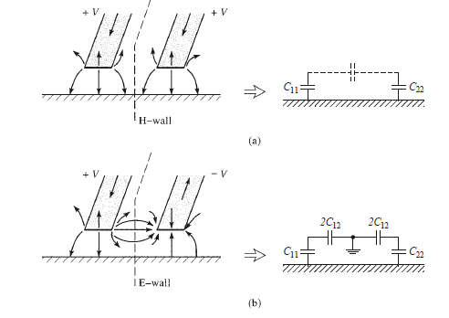
Even and Odd modes in coupled lines
Even mode
Odd mode
Odd mode
even mode

Slide 5
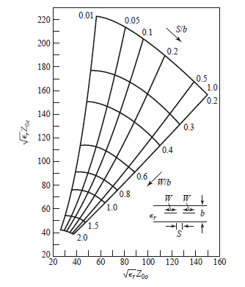
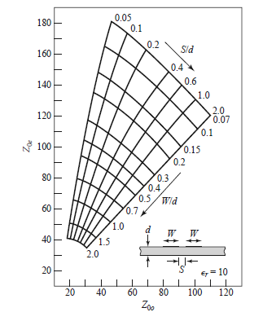
Coupled lines impedance charts
Strip Lines
Microstrip lines

Slide 6
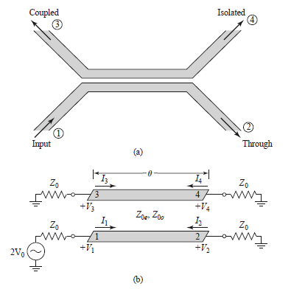
Directional coupler
Coupling coefficient

Slide 7
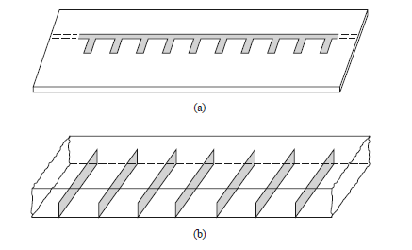
Introduction to microwave filter
Periodic structures
Image Parameters
Insertion loss method

